Slide 1

Pizza Place Sales Fiscal Year - 2015
Thomas Purcell
12/15/2022

Slide 2



Agenda
How many customers do we have each day?
Are there any peak hours?
How many pizzas are typically in an order?
Do we have any bestsellers?
How much money did we make this year?
Can we identify any seasonality in the sales?
Are there any pizzas we should take of the menu, or any promotions we could leverage?

Slide 3

Topic one
How many customers do we have each day?
On average the first of the month nets 820 customers, 15th 809 and 30th 627.

Slide 4
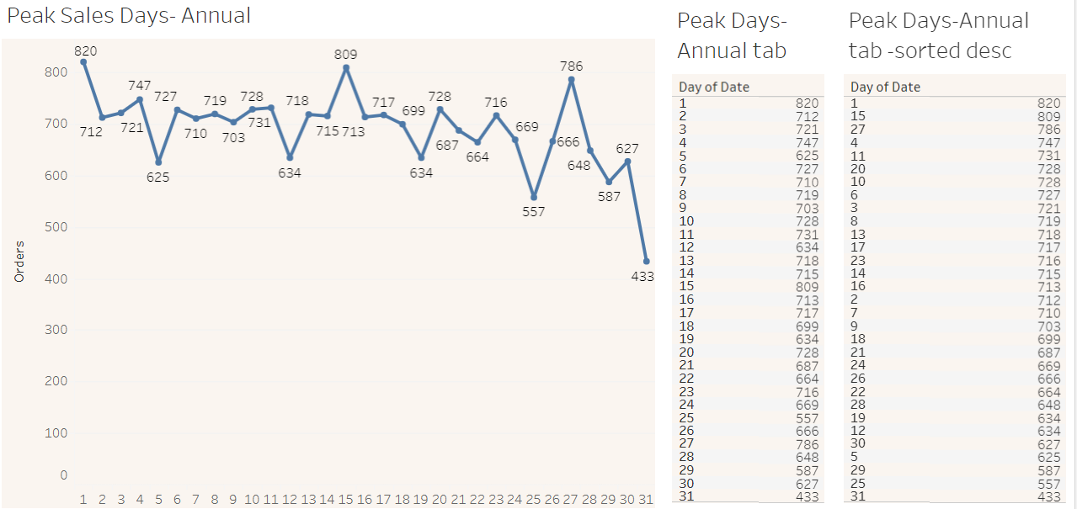
Annual-Daily Aggregate Sales

Slide 5
Topic two
Are there any peak hours?
On average noon is peak with 2520 orders annually. Six pm is next highest with 2399.

Slide 6
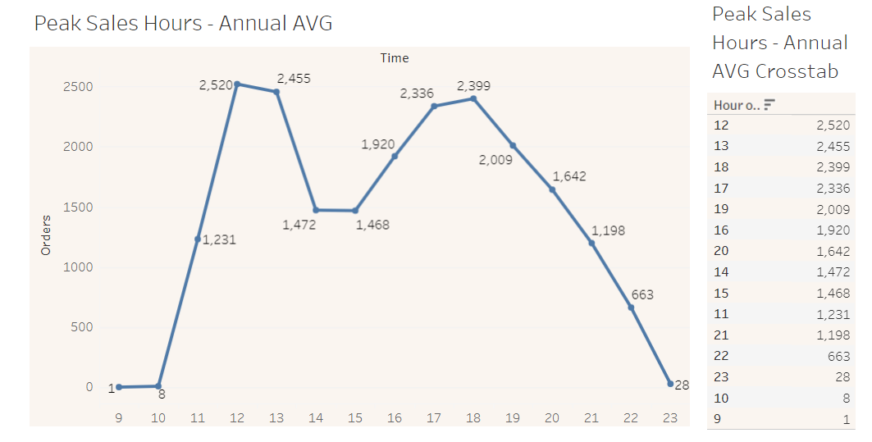
Average Peak Hours Annually

Slide 7
Topic three
How many pizzas are typically in an order?
Overall and on average one pizza per order.

Slide 8
Overall and on average one pizza per order.
Most Frequent:
1
Frequency:
47693
25%:
1
50%:
1
75%:
1
max:
4
mean:
1.0196
median:
1
min:
1
mode:
1
Rank #
1 , (47693)
2, (903)
3, (21)
4, (3)

Slide 9
Topic four
Do we have any bestsellers?
big_meat_s pizza is top seller @ 1914 units annually.

Slide 10
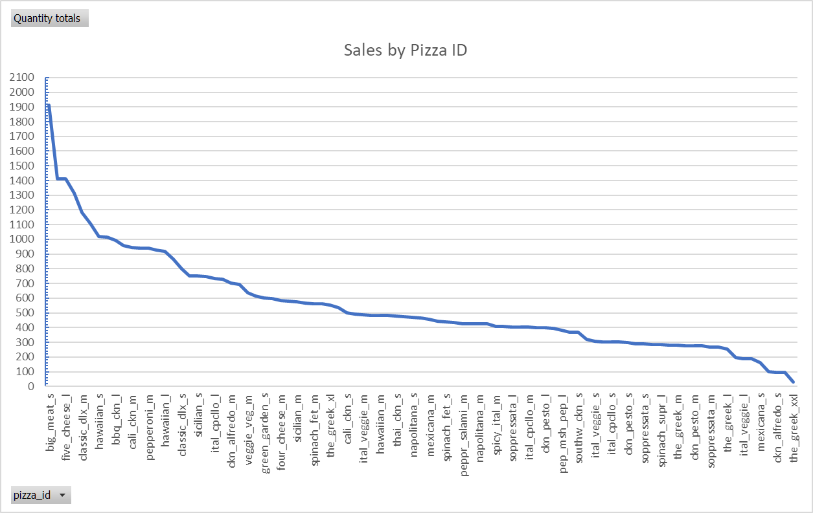
Best Sellers 2015
Annual Top Ten Pizzas
Pizza ID | Quantity totals
big_meat_s | 1914
thai_ckn_l | 1410
five_cheese_l | 1409
four_cheese_l | 1316
classic_dlx_m | 1181
spicy_ital_l | 1109
hawaiian_s | 1020
southw_ckn_l | 1016
bbq_ckn_l | 992
bbq_ckn_m | 956

Slide 11
Topic five
How much money did we make this year?
Annual Revenue = $817,860.05
Sum of total | Sum of quantity sold
$817860.05 | 49574

Slide 12
Topic six
Can we identify any seasonality in the sales?
July with highest sales (Weather and school vacations), followed by May and close behind is November. Low month is October.
July 4392
May 4328
Nov 4266
Oct 3883

Slide 13
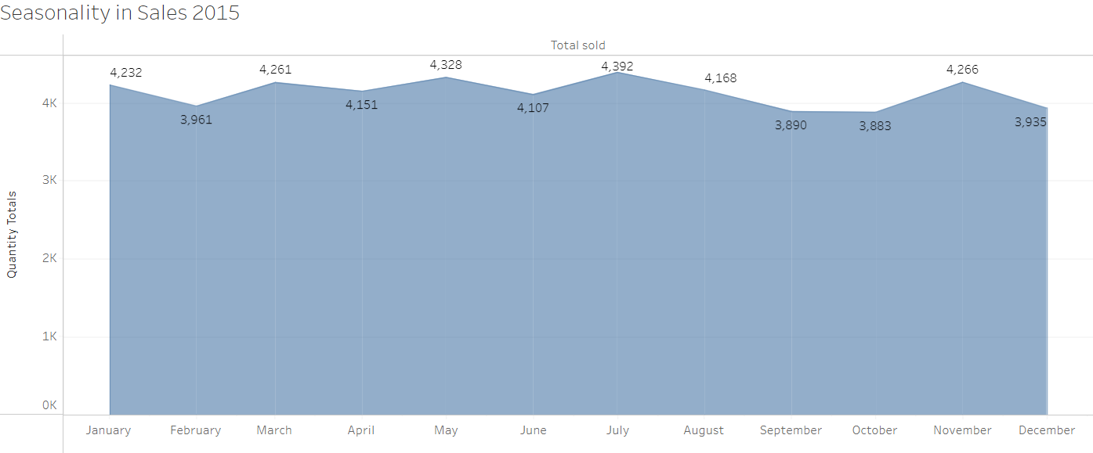
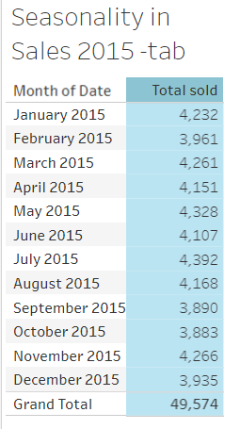
Annual Seasonality in sales

Slide 14
Topic seven
Are there any pizzas we should take of the menu, or any promotions we could leverage?
The eight least selling pizzas could be removed -
the_greek_xxl - 28, green_garden_l - 94, ckn_alfredo_s - 96, calabrese_s - 99, mexicana_s - 160, ckn_alfredo_l - 187, ital_veggie_l - 190, ital_supr_s - 194. Those that are also outside of top sellers could be promoted or eliminated based on cost savings or fresh demand.

Slide 15
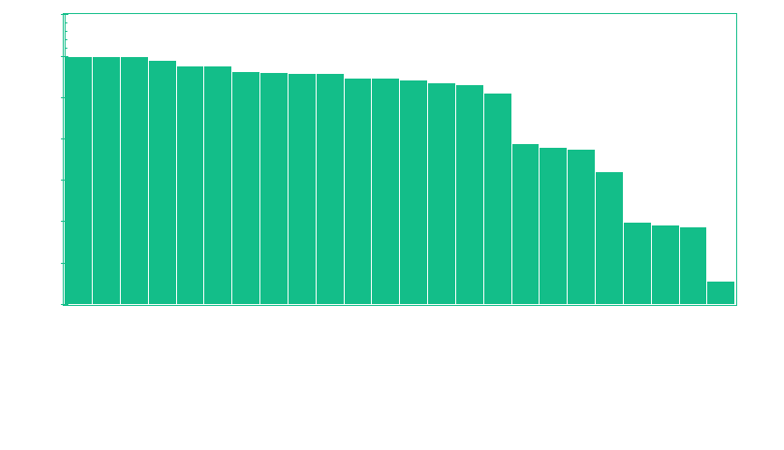
25 Least Active Pizza Codes - Annual

Slide 16


Thank You
Thomas Purcell
tpmail@yahoo.com
https://www.linkedin.com/in/vegasdatamart/

